Slide 1
Final Project: Halal or Haram
Data Science with Python
muksurat choudhury

Slide 2
Project Outline
Data Research Research Data Sources - Create Dataset – Review Data
Exploratory Data Analysis Correlation Matrix – Bar Charts – Pie Charts
Data Pre-Processing Organise & Convert Data
Machine Learning Models Random Forest – Linear Regression – Logistic Regression – Naïve-Bayes – KNN – Decision Tree – SVM
Streamlit Food Dataset – Codes Dataset
Notes:
This is a brief outline of my project starting with data research, then analysis, pre-processing and finally machine learning models

Slide 3
The Concept
The Long-Term Goal:
To create an app that is able to scan a barcode that identifies if the ingredients used in a product are Halal or Haram
To provide alternative Halal options if the product has any Haram ingredients
The ML Project:
To be able to enter a food ingredient or ingredient code and predict whether it is Haram, Halal, Makruh or Mushbooh using Machine Learning models
Notes:
My idea was to create an app that can scan barcodes from food products and identify if ingredients used in the product are halal or haram
The app would also suggest alternative products for any food products that have haram ingredients
Since I don’t have the resources to create an app right away, I focused on using machine learning models to predict whether a food ingredient or ingredient code is haram, halal, makruh or mushbooh

Slide 4
Haram
Forbidden or unlawful
Halal
Permissible
Halal food is that which adheres to Islamic law, as defined in the Qur’an. The Islamic form of slaughtering animals or poultry involves killing through a cut to the jugular vein, carotid artery and windpipe
Food that is prohibited according to Islamic law
Makruh
Disliked or undesirable
Mushbooh
Doubtful or suspect
If one is not sure about the slaughtering process or the ingredients used while preparing the food, then those items are considered as Mushbooh
Though a makruh act is not haram or subject to punishment, a person who abstains from this act will be rewarded
Notes:
To briefly explain what these words mean:
Haram means forbidden, it refers to food that is prohibited according to Islamic law
Halal means permissible and refers to food that is obtained by means according to Islamic law
Makruh means disliked or undesirable, it is not haram, but it is better to avoid
Mushbooh means it doubtful therefore also better to avoid

Slide 5
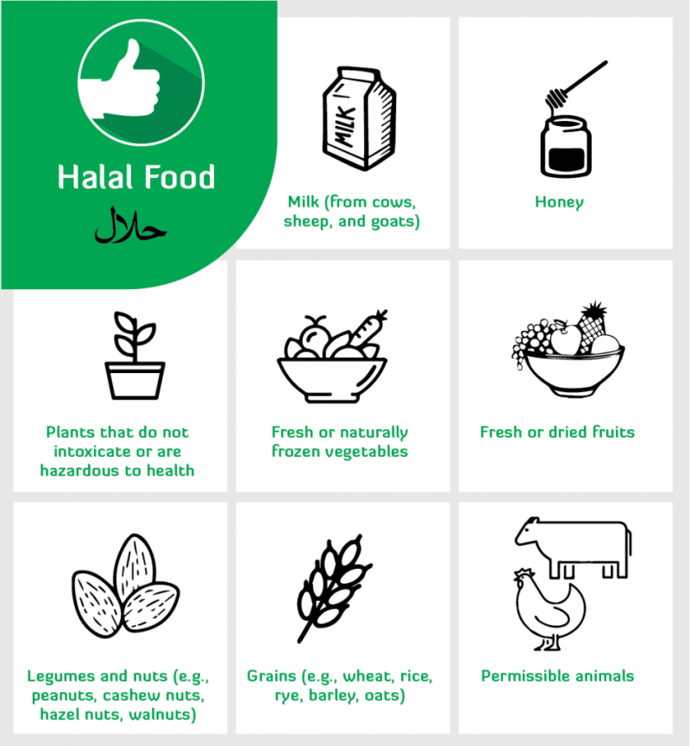
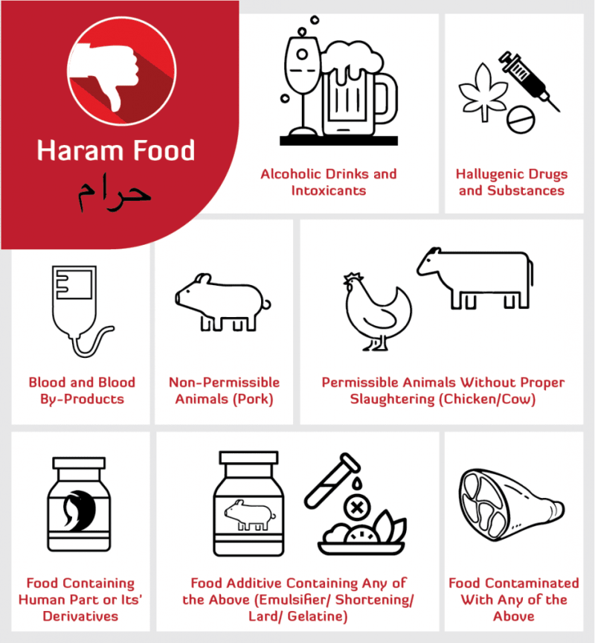
Notes:
Here are some examples of types of food that are halal or haram

Slide 6
Data Research
Notes:
I researched datasets online, and while there are a lot of studies on halal and haram food, I struggled to find raw data that could be used in my study
So collected information from a couple of different sources and I used excel to create my own datasets and imported that into VS code

Slide 7
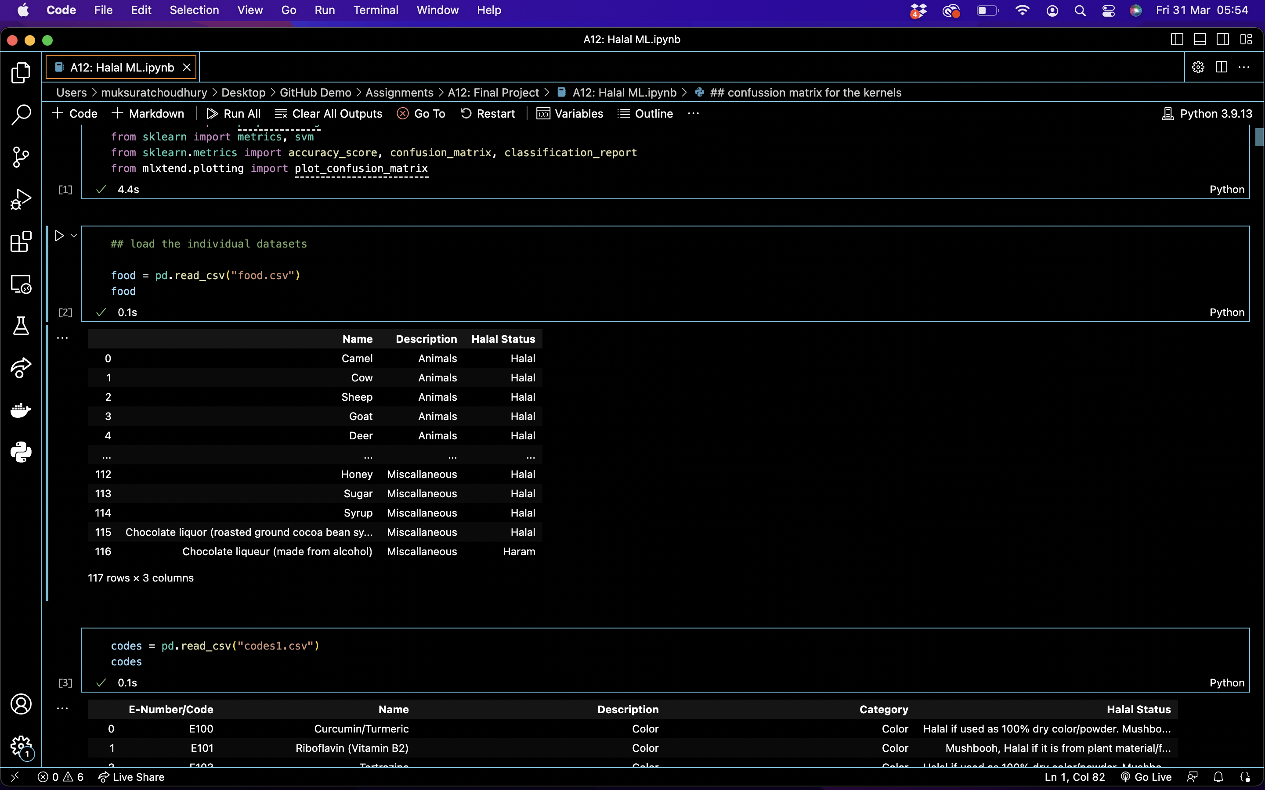
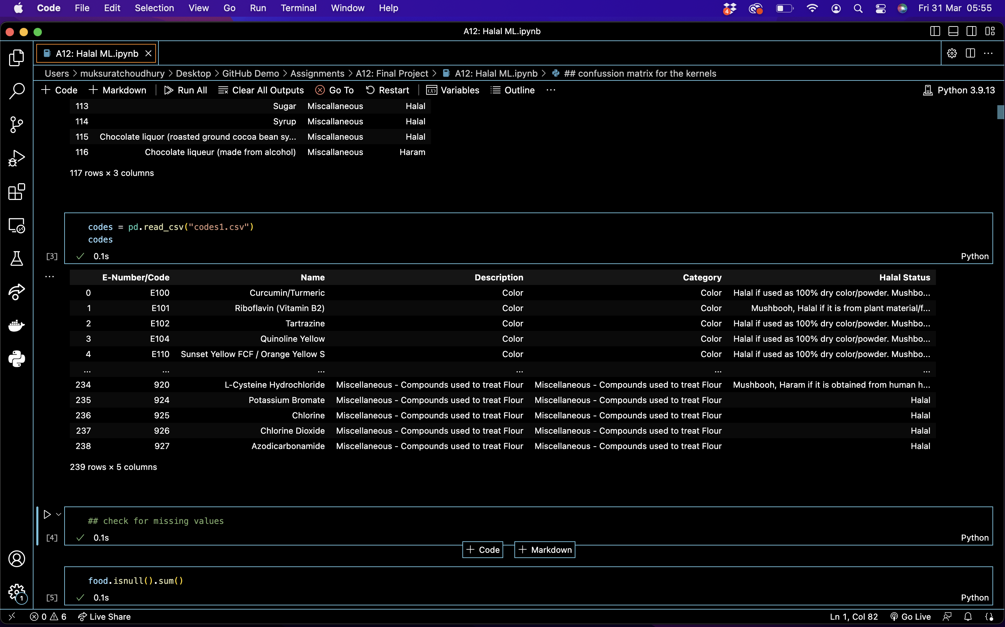
The Data
Dataset 1: Food
Dataset 2:
Codes
Notes:
I found 2 types of data so I split them into 2 datasets
1 is the food dataset that are items of food ingredients
2 is the codes dataset that are items of ingredient codes or numbers that you might find on an ingredients list within food that you buy

Slide 8
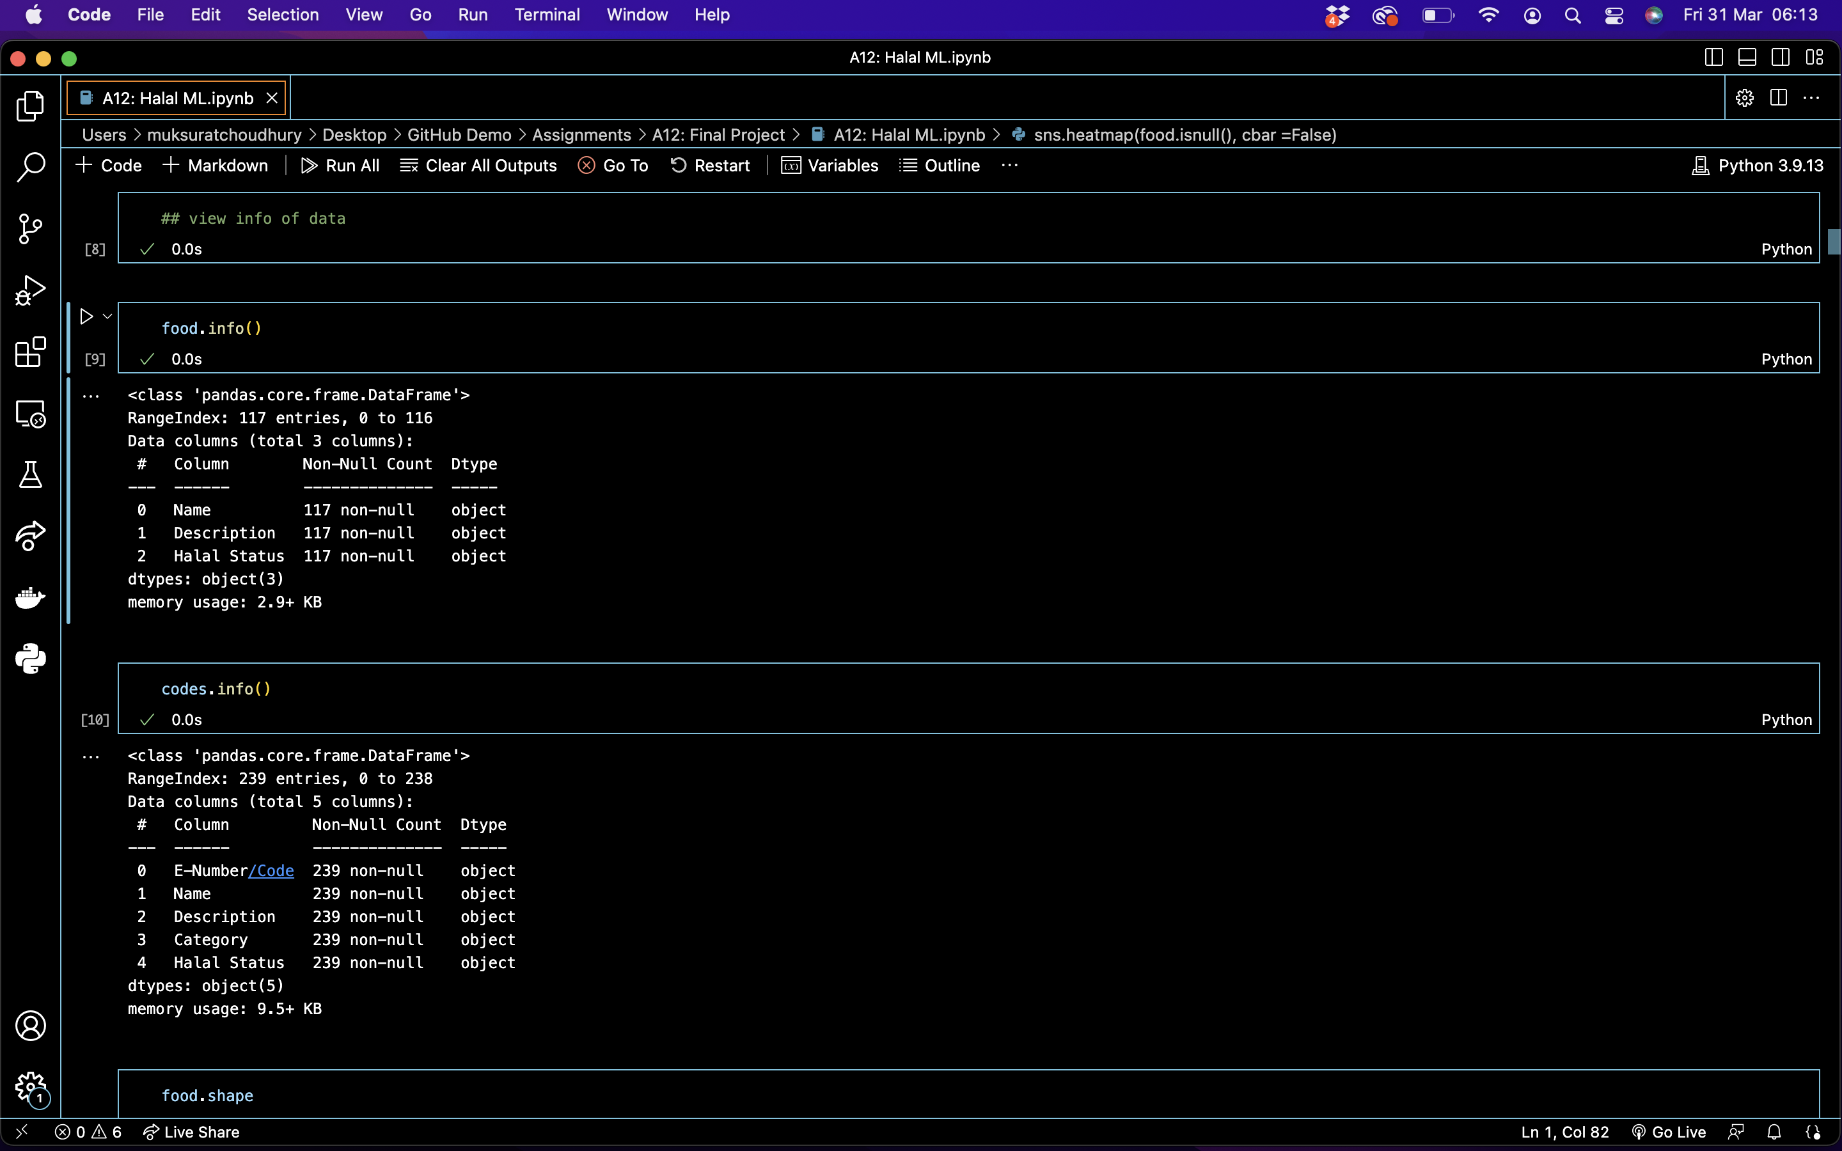
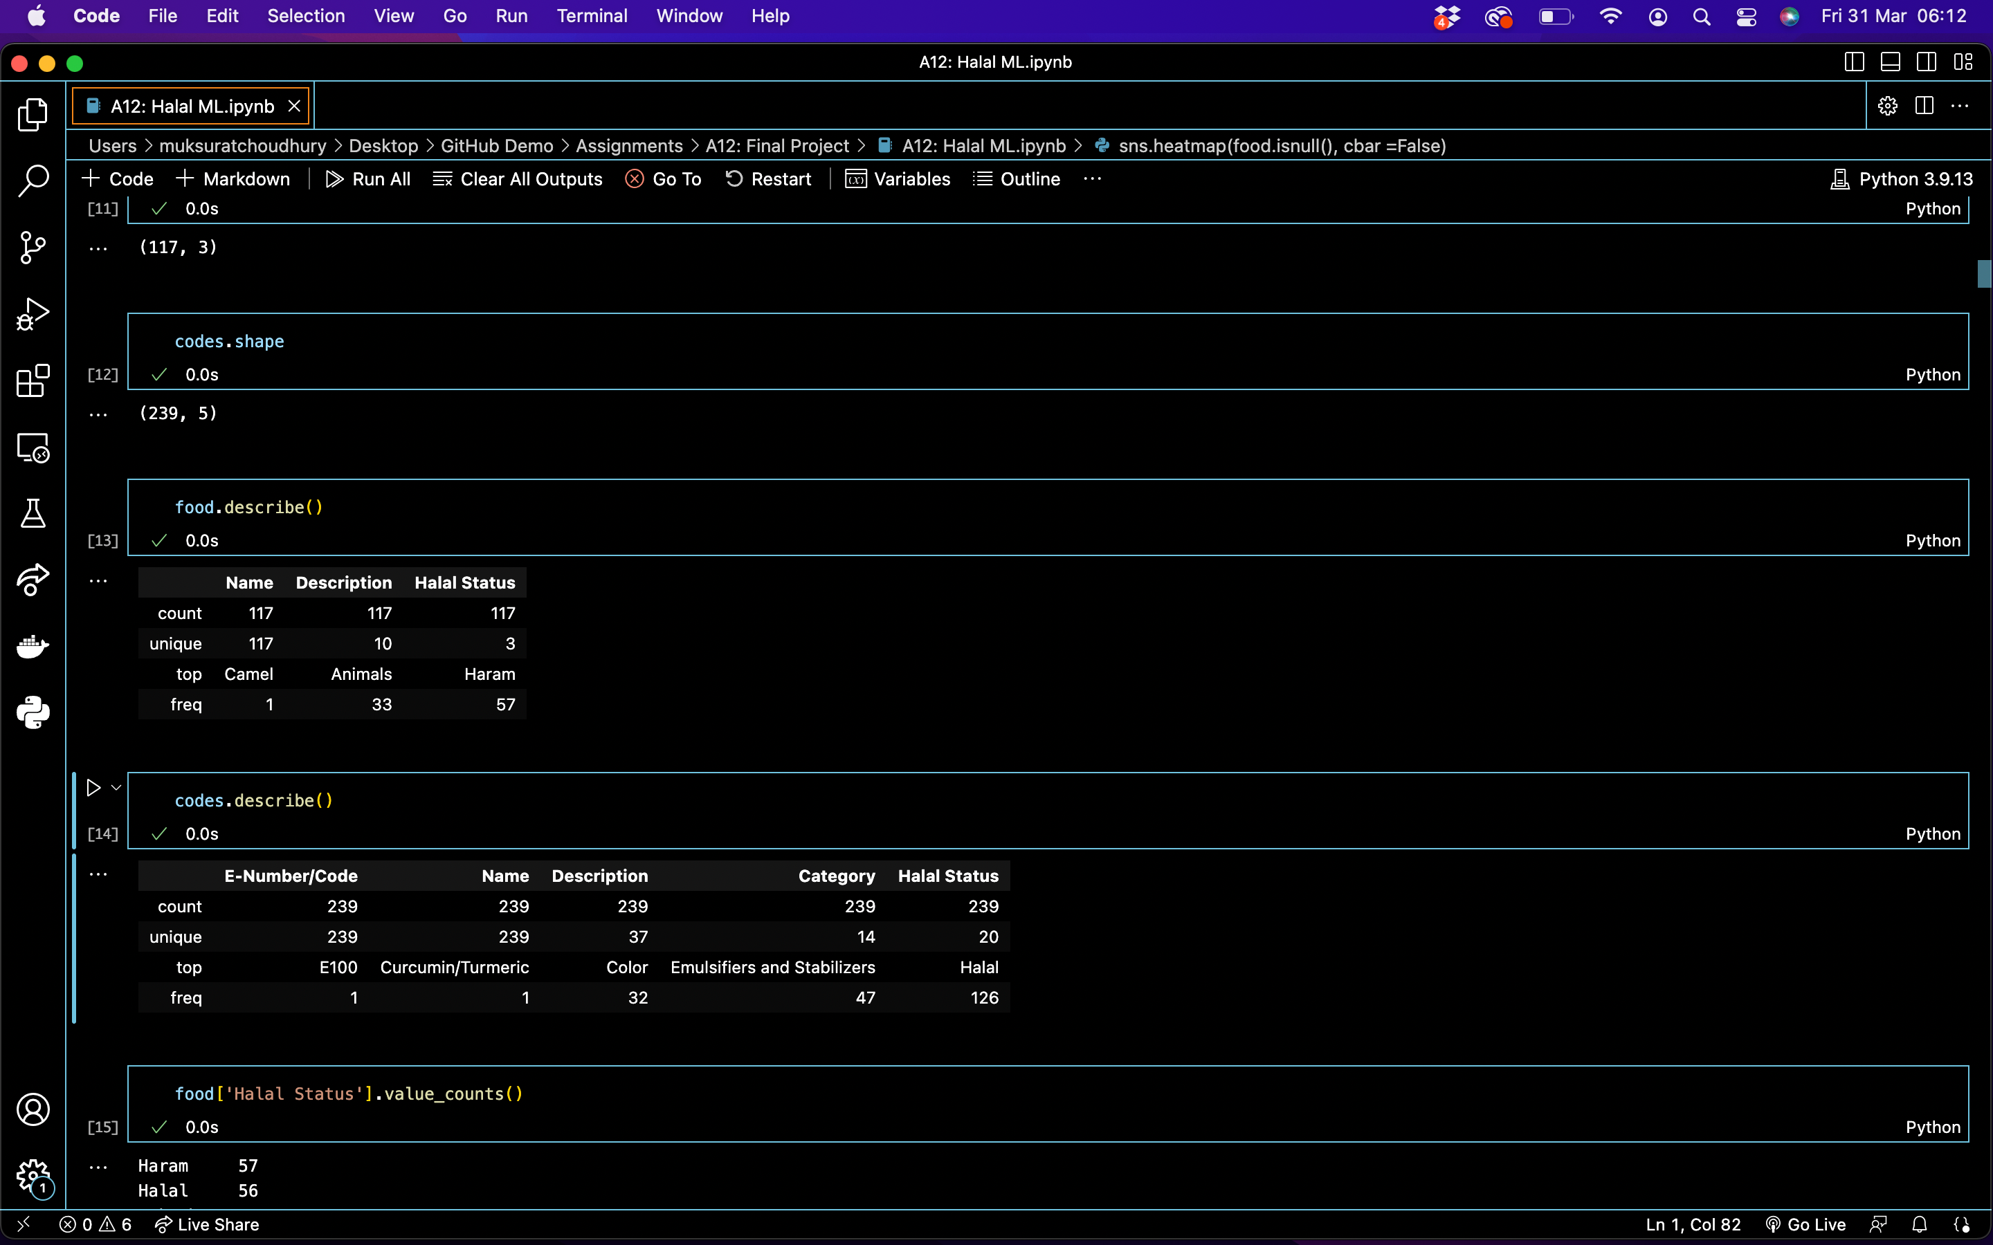

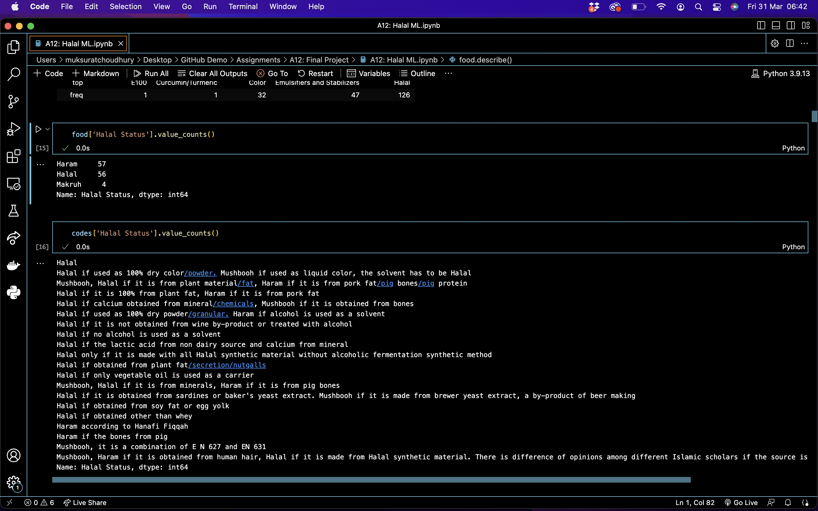
Dataset 1: Food
Dataset 2:
Codes
Notes:
I reviewed the 2 datasets using info and describe
In the food dataset, there are 117 food items in total and 10 description categories they fall under with 3 possible halal status results
This means they can be Halal, Haram or Makruh which means it is permitted, but disliked
In the codes dataset, there are 239 ingredient codes that are spread across 37 description categories with 20 possible halal status results
The reason there are 20 Halal statuses is because the ingredient codes can be either Halal or Halal under certain conditions so it isn’t as clear cut as Haram or Halal

Slide 9
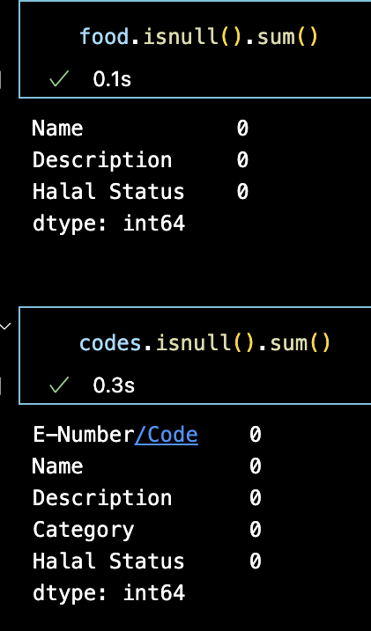
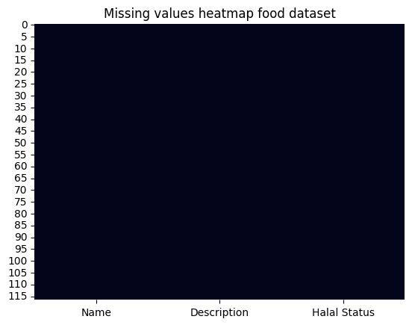
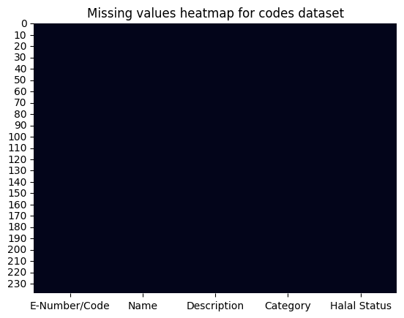
Missing Values
Dataset 1: Food
Dataset 2:
Codes
Notes:
Since I created the dataset myself, there are no missing values in the datasets, I used the code and chart to view in case of any human error

Slide 10
Exploratory Data Analysis
Notes:
Moving onto data analysis

Slide 11
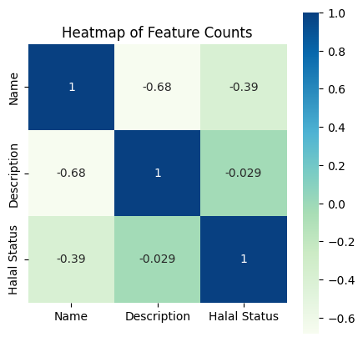
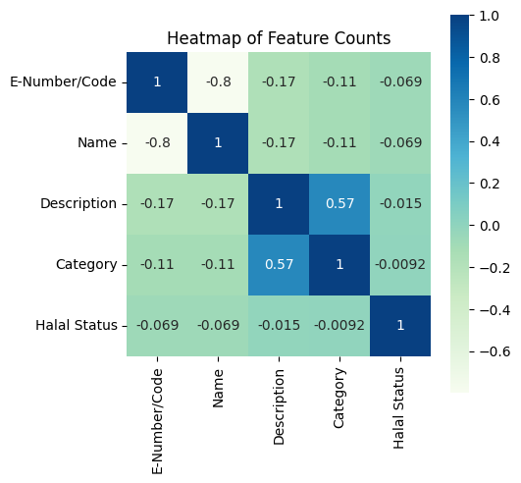
Dataset 1: Food
Dataset 2:
Codes
Notes:
These are some heatmaps to show any correlations to feature counts in both datasets
We can’t really see any significant correlations from the limited data so there might be a case of underfitting later

Slide 12
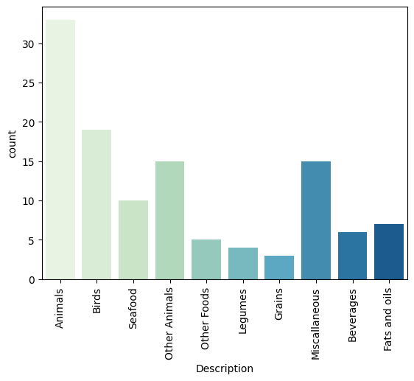
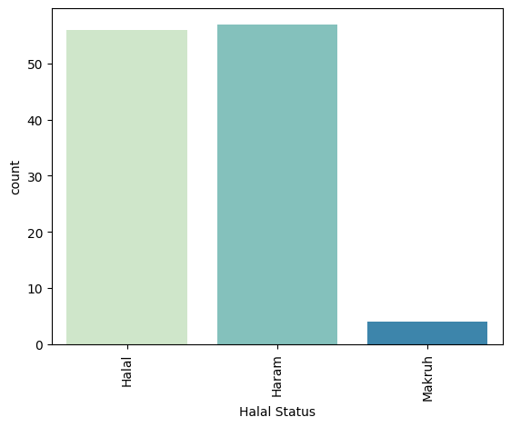
Dataset 1: Food
Dataset 1: Food
Notes:
I created bar charts of both datasets
This is the food dataset where you can see animals is the most common category followed by birds and grains is the least common category
On the right you can see the halal status where haram and halal foods are almost the same amount, while there are very few makruh foods

Slide 13
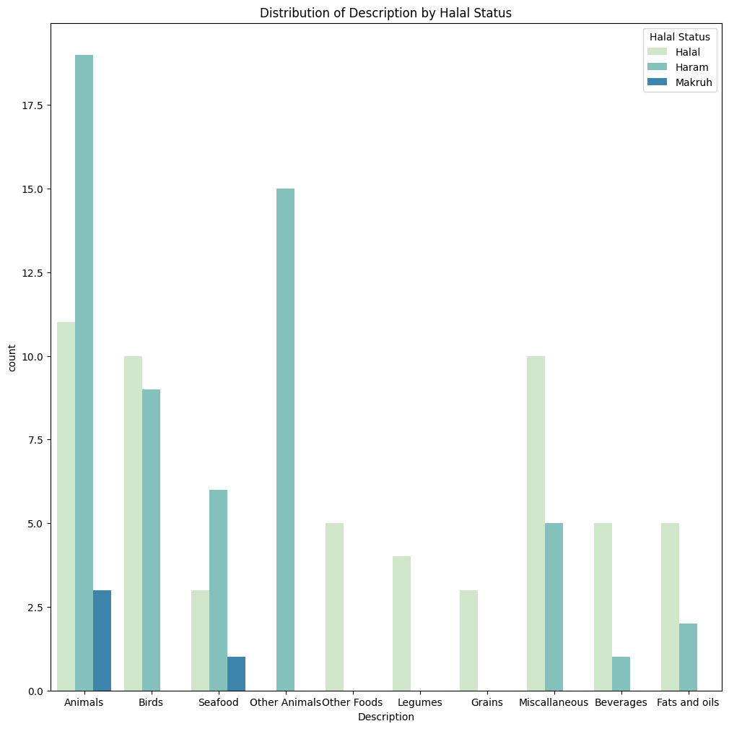
Dataset 1: Food
Notes:
I put the charts together to show the distribution of halal status within in each category
For example under animals, there are more haram foods than halal and some makruh
All of legumes, grains and other category foods are found to be halal
While all of other animals category is found to be haram (this category had some animals like lizards, flies, etc)

Slide 14
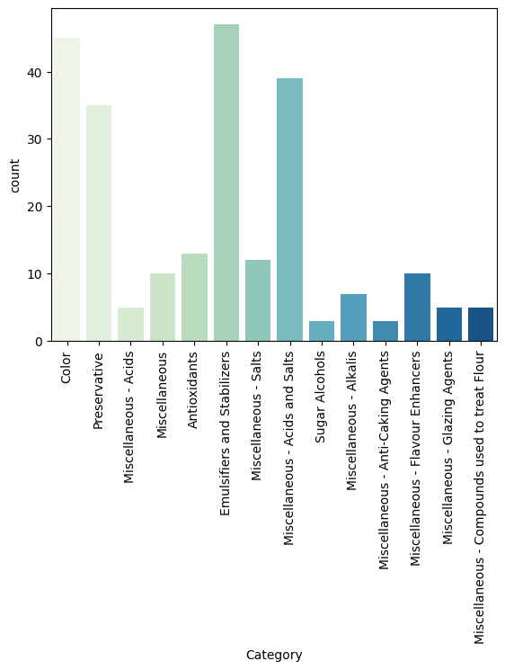
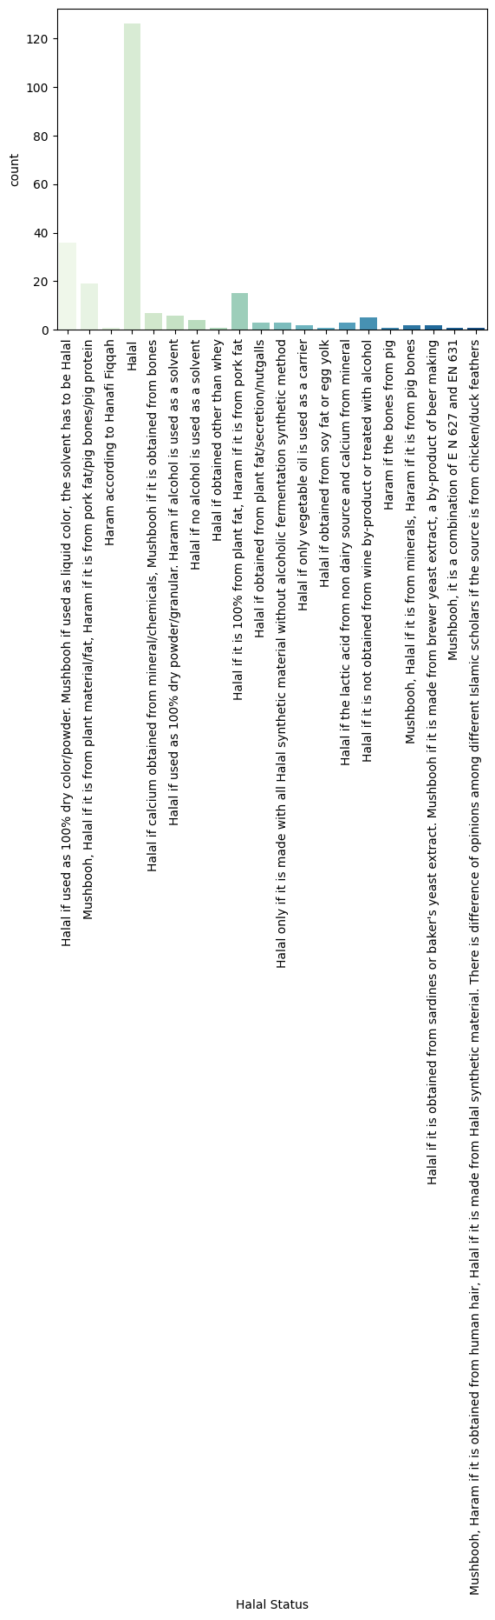
Dataset 2:
Codes
Dataset 2:
Codes
Notes:
I did the same for the codes dataset
Where you can see emulsifiers and stablizers and colors are the most common categories
While sugar alcohols and anti caking agents are the least common categories
On the right you can see the halal status where halal options are most common. I should have put these charts horizontal so it is easier to read, but the other options here not simply halal or haram, they are halal if followed by certain condition or haram if not

Slide 15
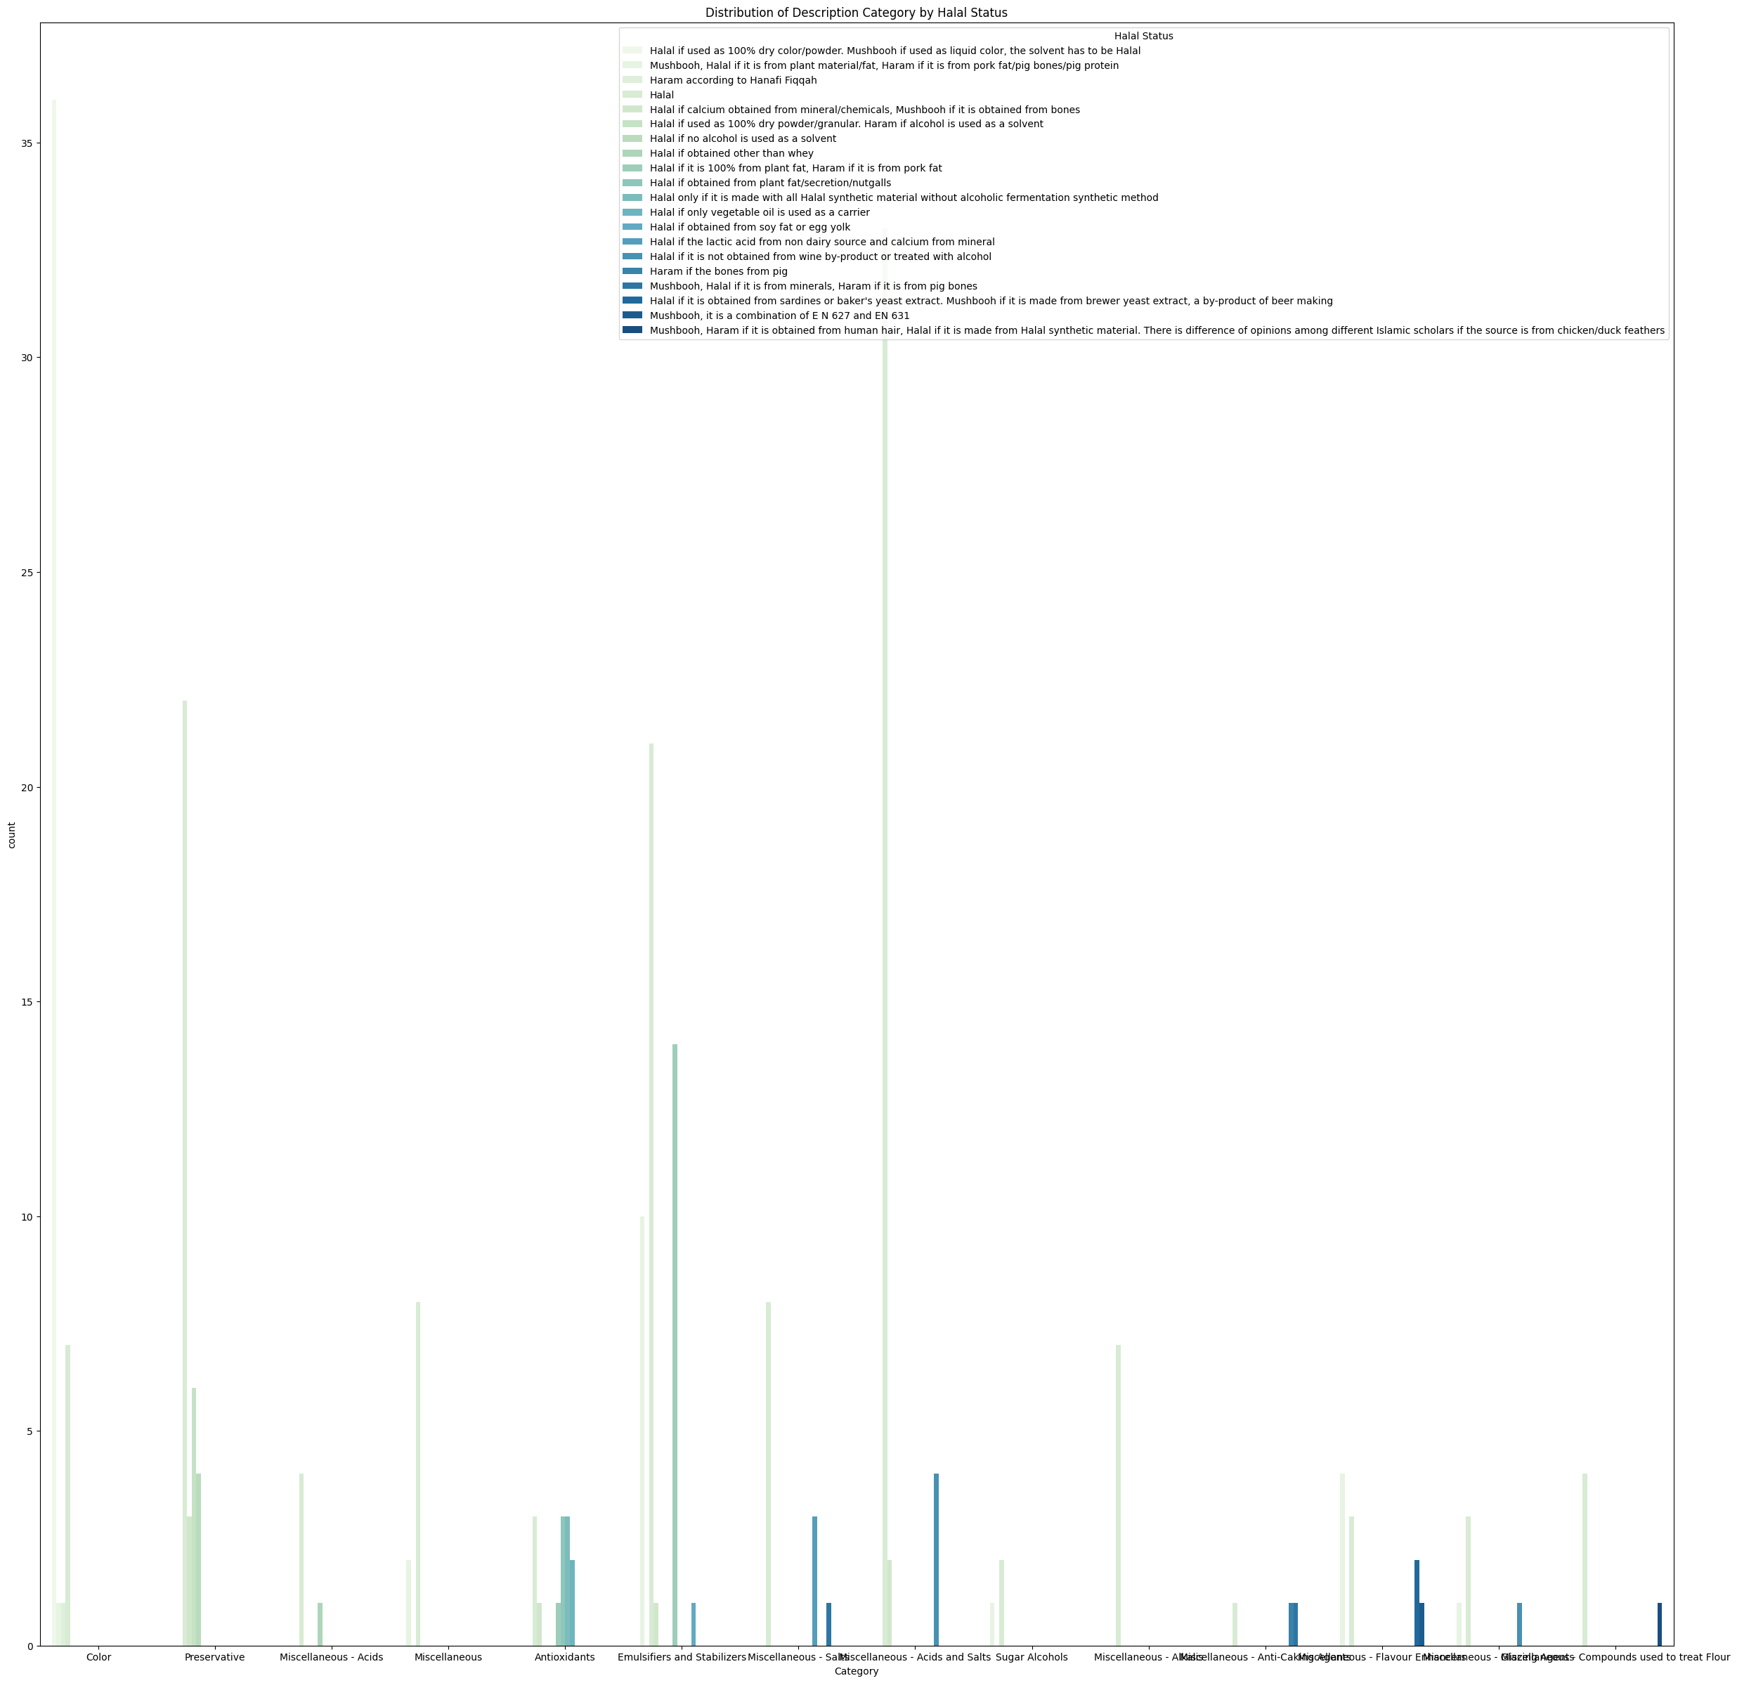
Dataset 2:
Codes
Notes:
Again, I put the charts together to show the distribution of halal status within in each category
Sorry its not easy to read, but I found that most of the halal codes fall under the acids and salts category followed by preseravatives

Slide 16
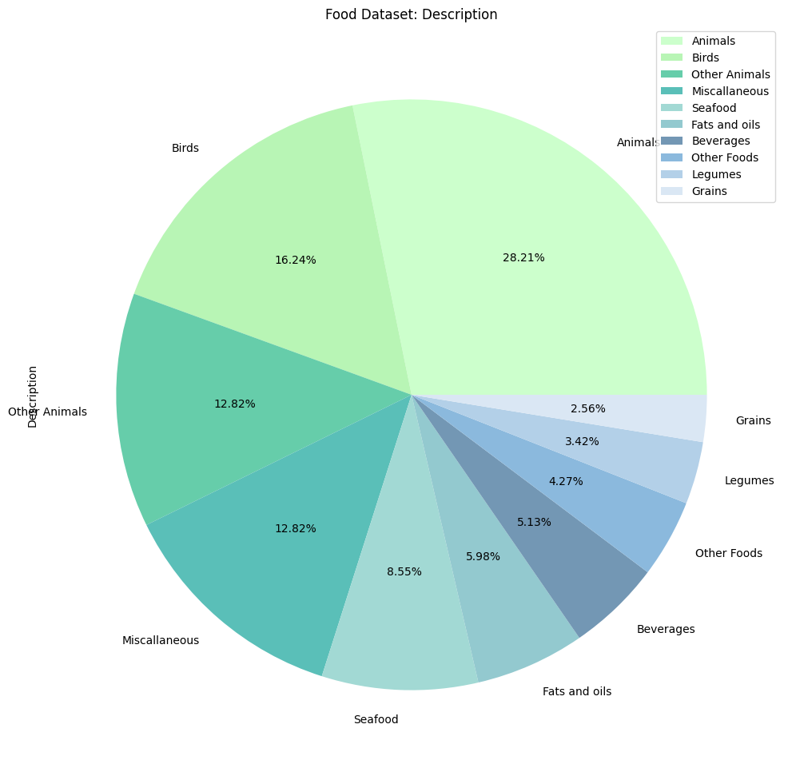
Dataset 1: Food
Notes:
These are some pie charts showing the distribution of categories of food

Slide 17
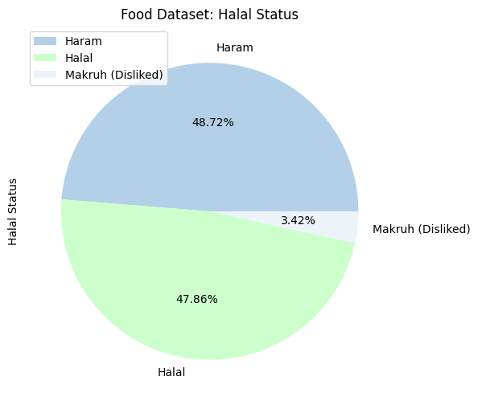
Dataset 1: Food
Notes:
This one shows the distribution of halal and haram food in the food dataset that are almost equally haram and halal

Slide 18
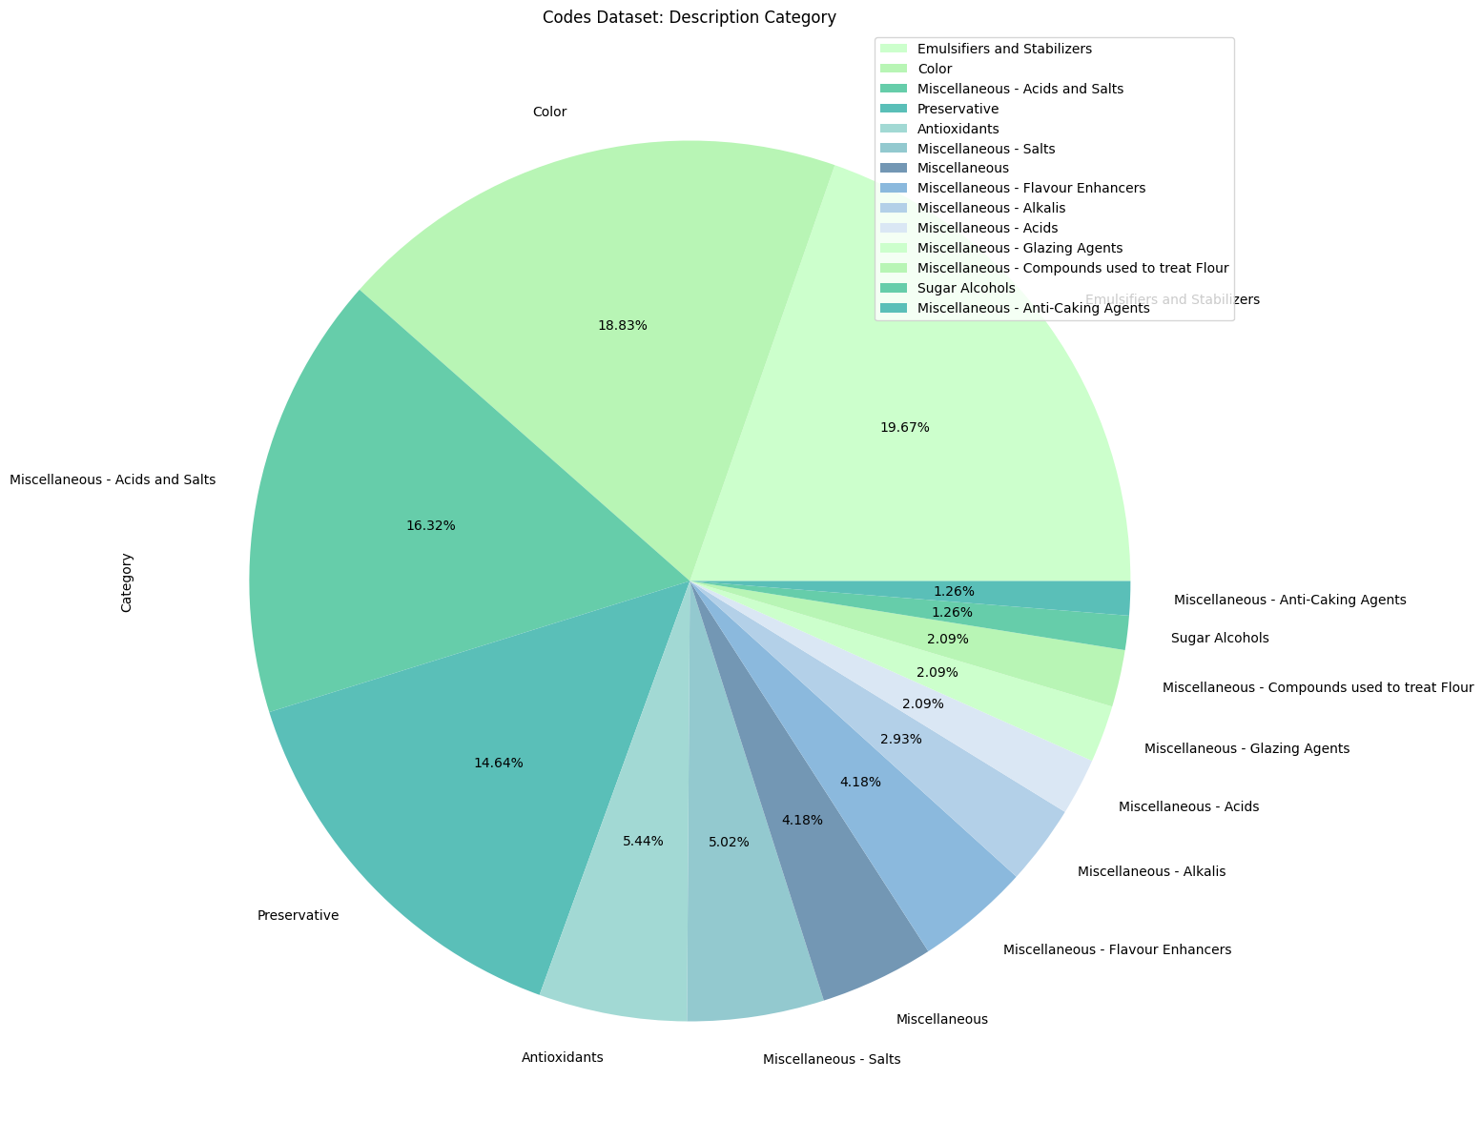
Dataset 2:
Codes
Notes:
And again for the codes dataset, the distribution of different categories for codes

Slide 19
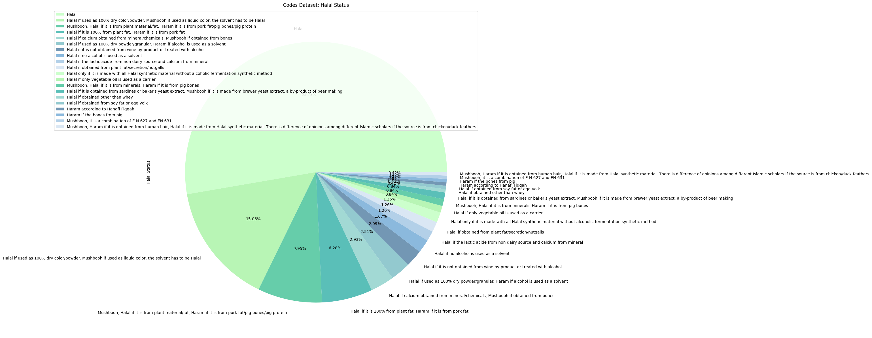
Dataset 2:
Codes
Notes:
This pie chart shows that over 50% is halal without any conditions while the remaining are all halal dependent on certain factors

Slide 20
Machine Learning Models
Notes:
In order to perform machine learning, as part of data pre-processing I used label encoder on both datasets to convert all the data to numerical data and arrays
I used a number of machine learning models with testing of 30% and training of 70% and the target variable of halal status

Slide 21
 | Dataset 1: Food | Dataset 2: Codes
ML Model | Accuracy | Accuracy
Random Forest Classifier | 55.6% | 70.8%
Linear Regression | MAE: 0.5583463123146999 MSE: 0.37120415829759934 RMSE: 0.6092652610297089 R2: -0.04810585872263329 | MAE: 4.727417991897589 MSE: 35.27600220083881 RMSE: 5.939360420183204 R2: 0.01184572059704847
Logistic Regression | 38.8% | 47.2%
Naïve-Bayes | 38.8% | 56.9%
K-Nearest Neighbours | 52.7% | 61.1%
Decision Tree Classifier: Gini | 44.4% | 61.1%
Decision Tree Classifier: Entropy | 55.5% | 59.7%
Decision Tree Classifier: Max Depth | 50.0% | 62.5%
SVM Classifier: Linear Kernel | 47.2% | 65.2%
SVM Classifier: Sigmoid Kernel | 50.0% | 41.6%
SVM Classifier: RBF Kernel | 44.4% | 43.1%
Notes:
This is a summary of the different models I used, the model with the highest accuracy in both datasets is the Random Forest at 55.6% and 70.8%
None of the models are particularly high in accuracy, in fact the accuracy levels are rather low
This is likely due to underfitting as there simply isn’t enough data to be trained, it needs more features as the learning model is not complex enough to accurately capture relationships between the features of the datasets and the target variable of halal status which we saw earlier on in the data analysis, particularly the correlation matrix heatmaps

Slide 22
Thank You
Notes:
I wanted to create a streamlit that predicts if an ingredient is halal or haram based on user input, however
I wasn’t able to create a streamlit due to the issue I have with python in my computer, but I suspect the results would be 50-50% chance of accurately predicting if an ingredient entered is halal or haram due to the low accuracy rates in the machine learning models as a result of underfitting

